Slide 1
SOLID Principles
Sammi Aldhi Yanto
A nice guy, Gopher, and Kotlin Enthusiast

Slide 2
Introduction to SOLID

Slide 3
Hmmm SOLID
SOLID principles are an object-oriented approach that are applied to software structure design
It is conceptualized by Robert C. Martin (also known as Uncle Bob)
The SOLID principles is not a particular law or rule that we are obliged to obey, but rather a principle that is meant to assist us in writing neat code
It also ensures that the software is modular, tolerant of change, easy to understand, debug, refactor, and the basic components can be reused in the form of other system software

Slide 4

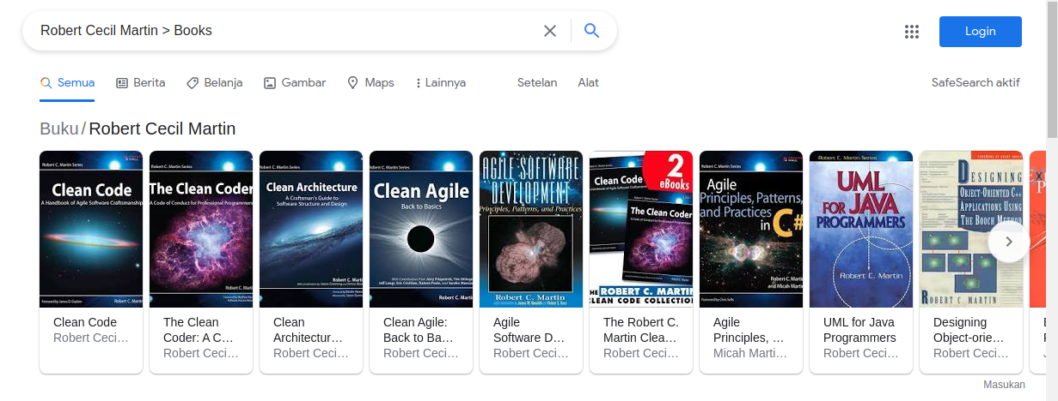
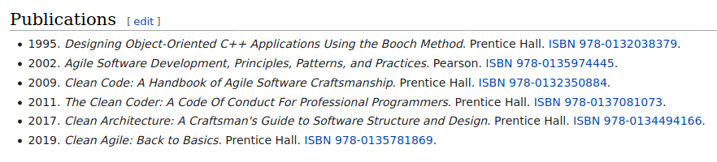
Robert Cecil Martin, colloquially called "Uncle Bob", is an American software engineer, instructor, and best-selling author. He is most recognized for developing many software design principles and for being a founder of the influential Agile Manifesto

Slide 5
The word SOLID acronym for
Single Responsibility Principle (SRP)
Open-Closed Principle (OCP)
Liskov Substitution Principle (LSP)
Interface Segregation Principle (ISP)
Dependency Inversion Principle (DIP)

Slide 6
Single Responsibility Principle
Every Java class must perform a single functionality
Responsibility means that if a class has 2 (two) unrelated functionality to make a change, then we have to divide the different functionality in one way into two different classes
Each class that has been separated based on its functionality will only handle one responsibility
We just need to focus on each class that has been separated

Slide 7
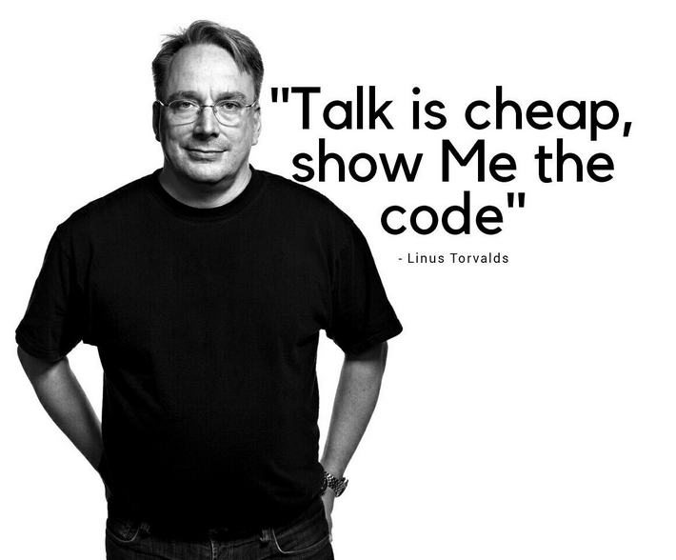

Slide 8
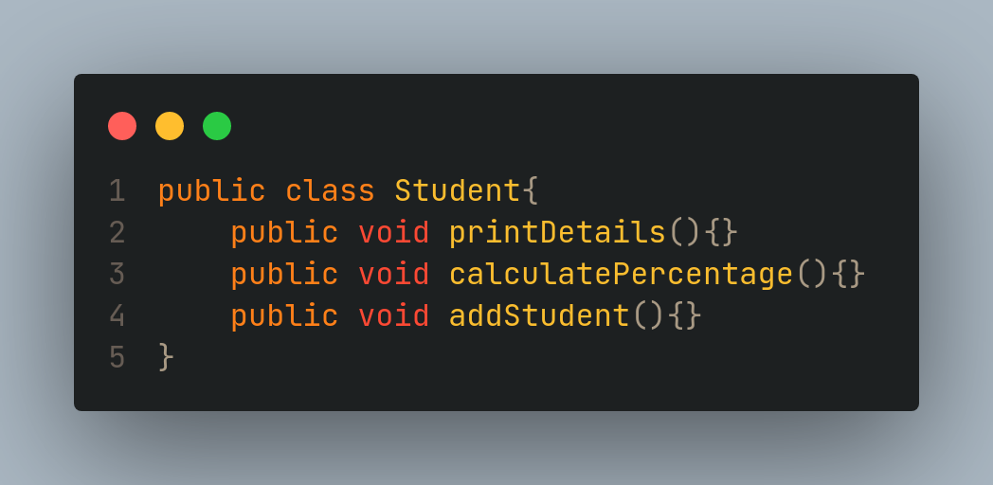
Let's understand the SRP through an example

Slide 9
Ooops!
The code snippet violates the single responsibility principle. To achieve the goal of the principle, we should implement a separate class that performs a single functionality only.

Slide 10
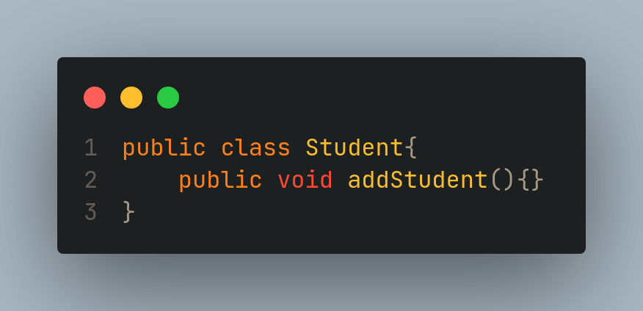
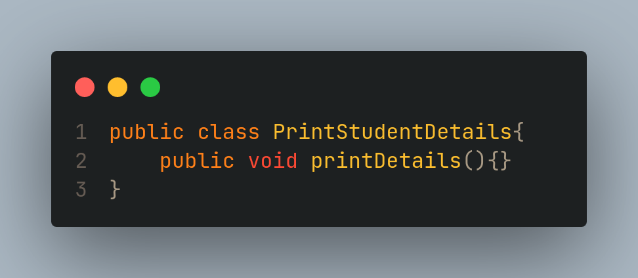
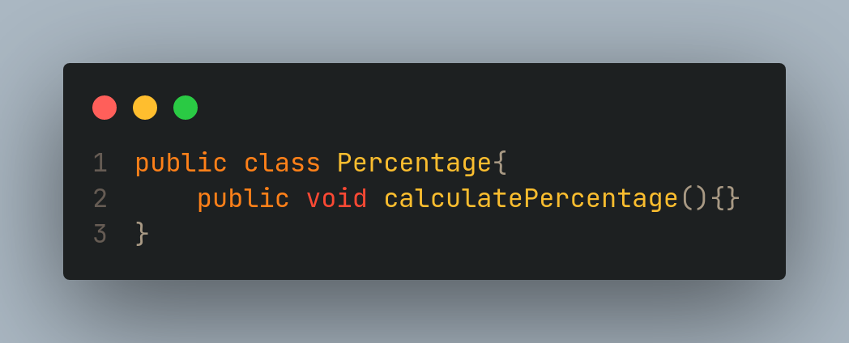

Slide 11
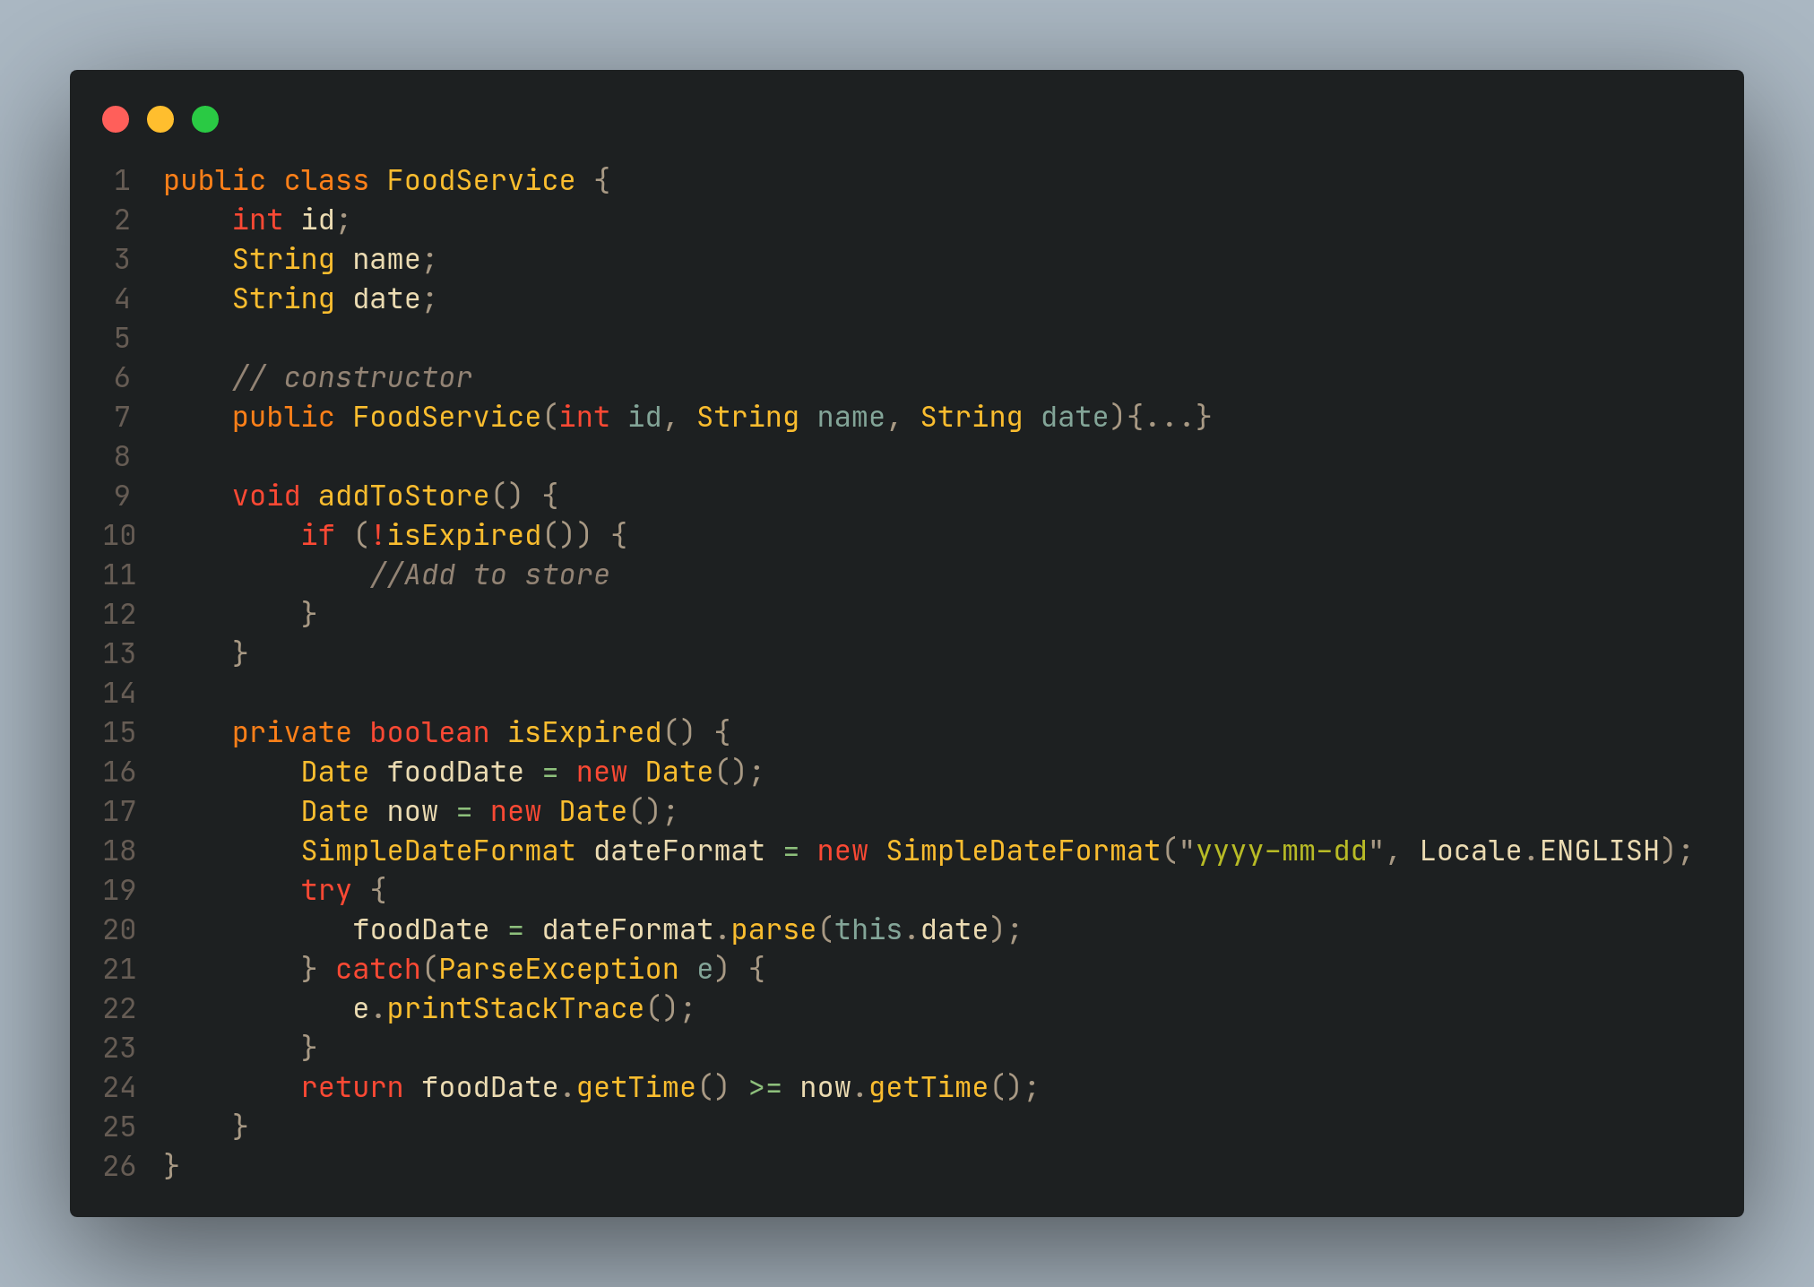

Slide 12
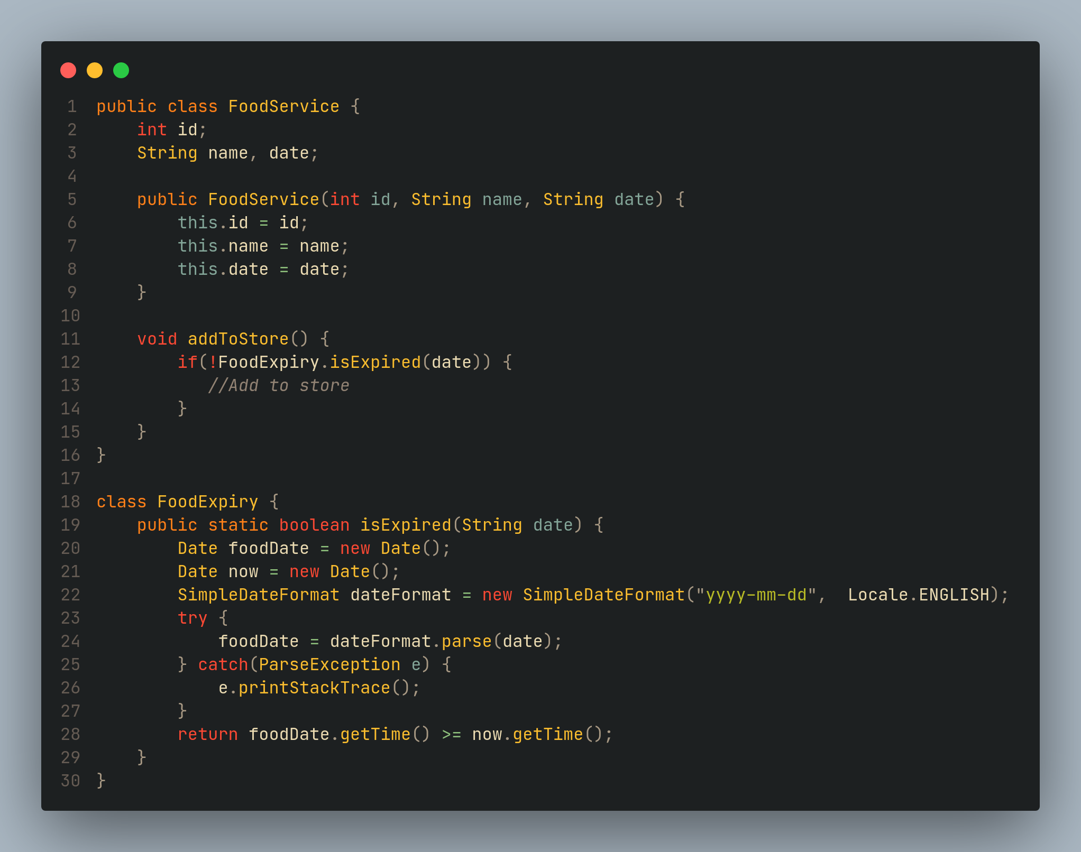

Slide 13

Open-Closed Principle
the module should be open for extension but closed for modification
The extension allows us to implement new functionality to the module

Slide 14
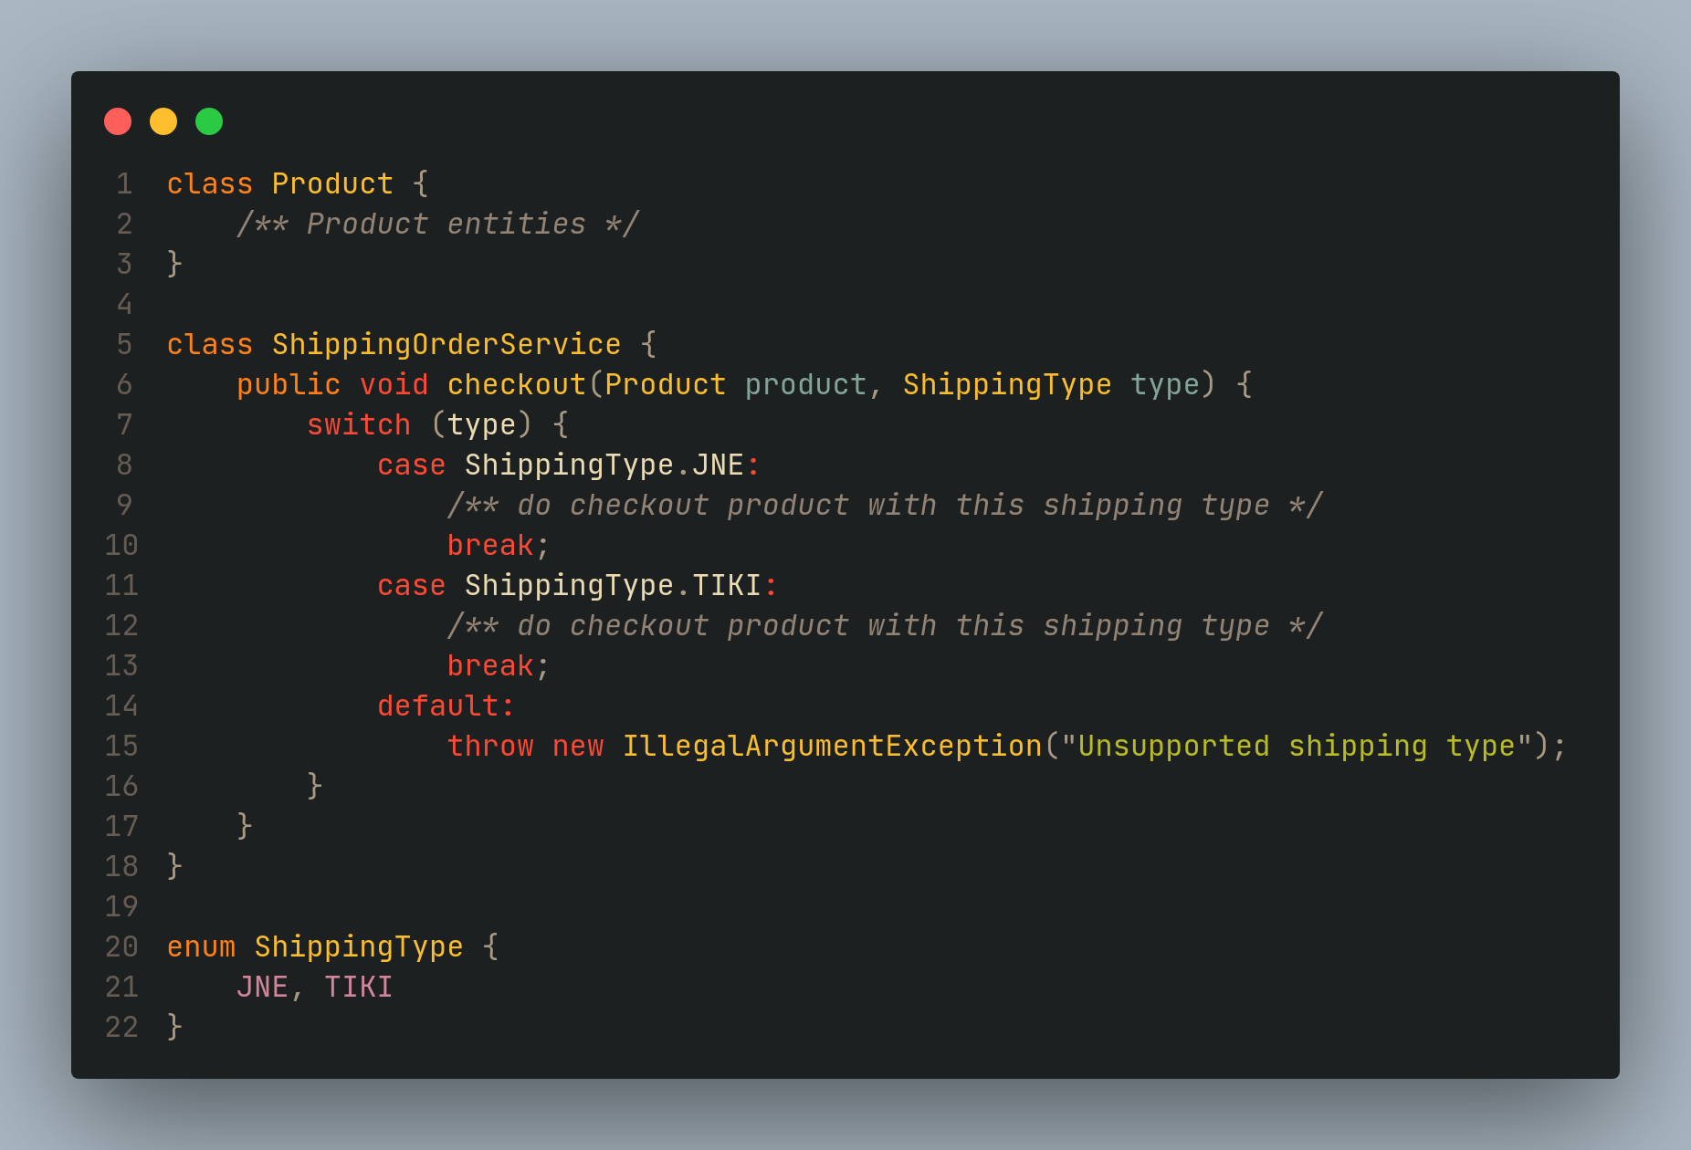
Let's understand the OCP through an example

Slide 15
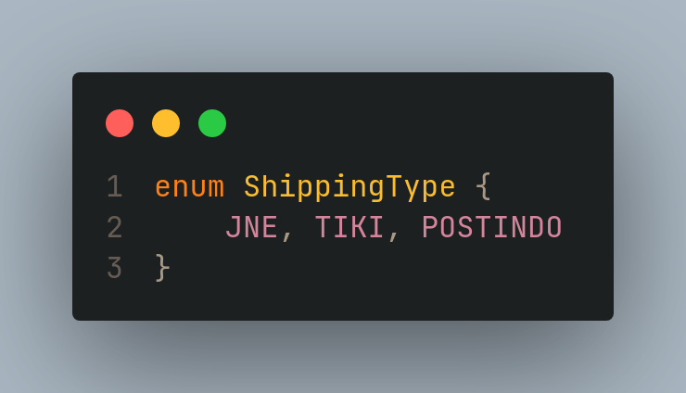
Ooops!

Slide 16
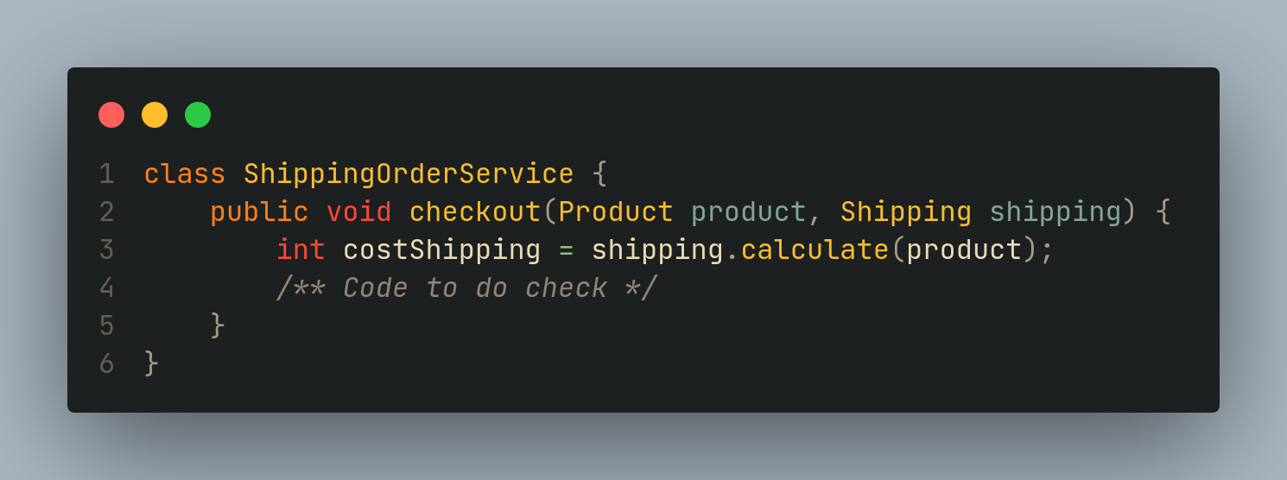
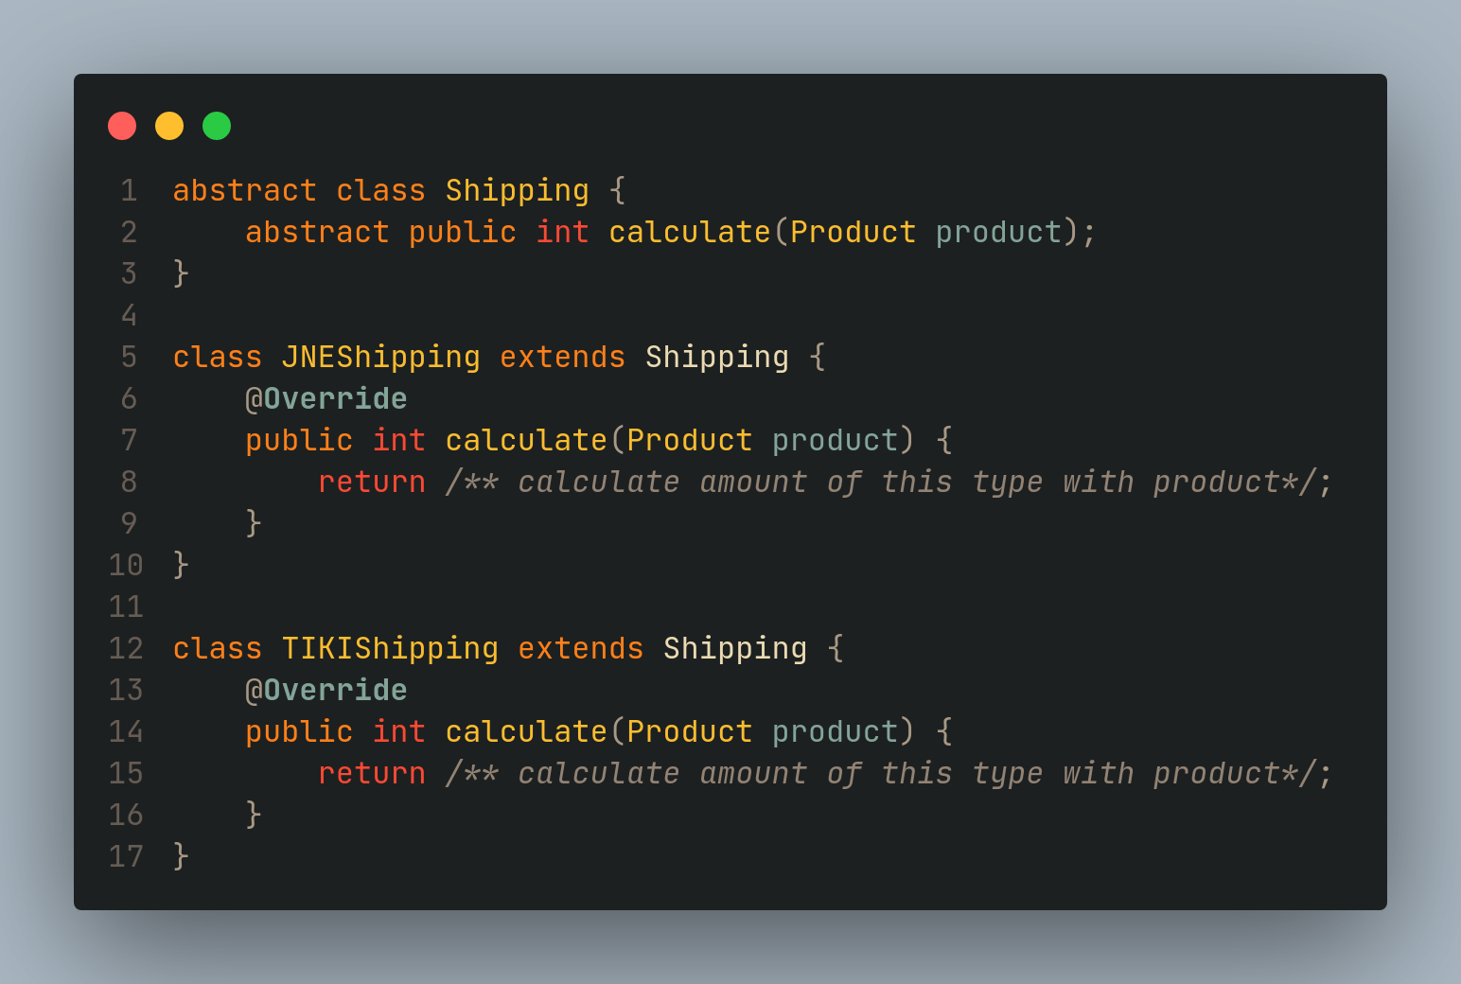

Slide 17
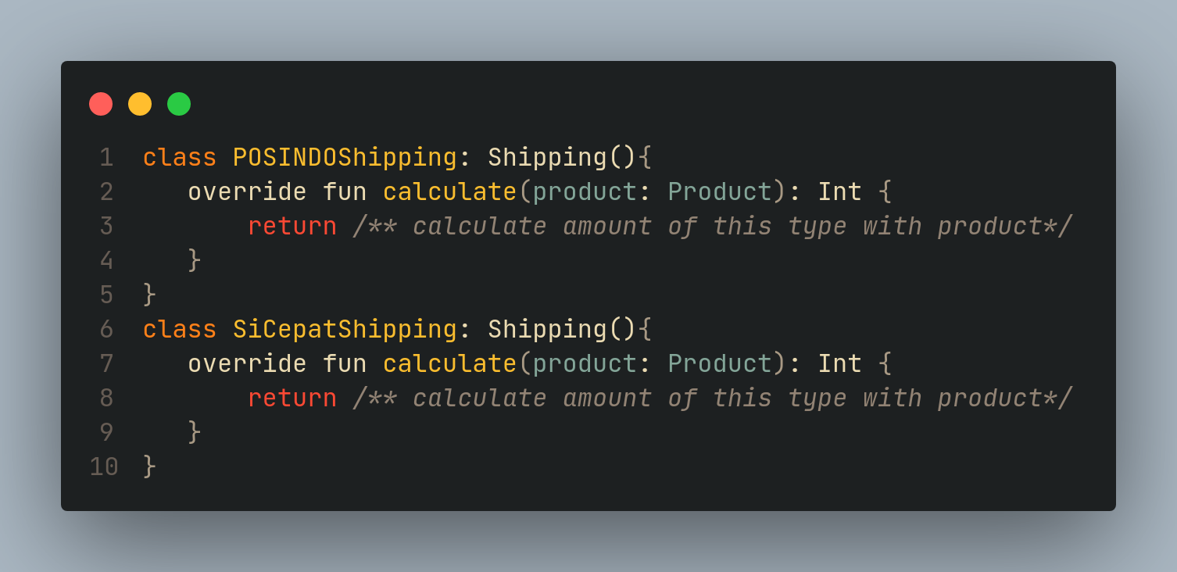

Slide 18
Liskov Substitution Principle
The Liskov Substitution Principle (LSP) was introduced by Barbara Liskov
Simply put, Liskov's substitution is the rule that applies to hierarchical inheritance
All SubClass can run at least the same way as its SuperClass.

Slide 19
there are several rules that must be obeyed
Contravariant is a condition in which the parameters of a function in the SubClass must have the same type and number as the function in its SuperClass. Meanwhile, Covariant is a condition to return the value of functions that are in SubClass and SuperClass
Preconditions and Postconditions. These are actions that must exist before or after a process is executed
The Constraints here are the restrictions the SuperClass imposes on changing the state of an object
For example, suppose that the SuperClass has an object that has a fixed value, then the SubClass is not allowed to change the state of the object's value

Slide 20
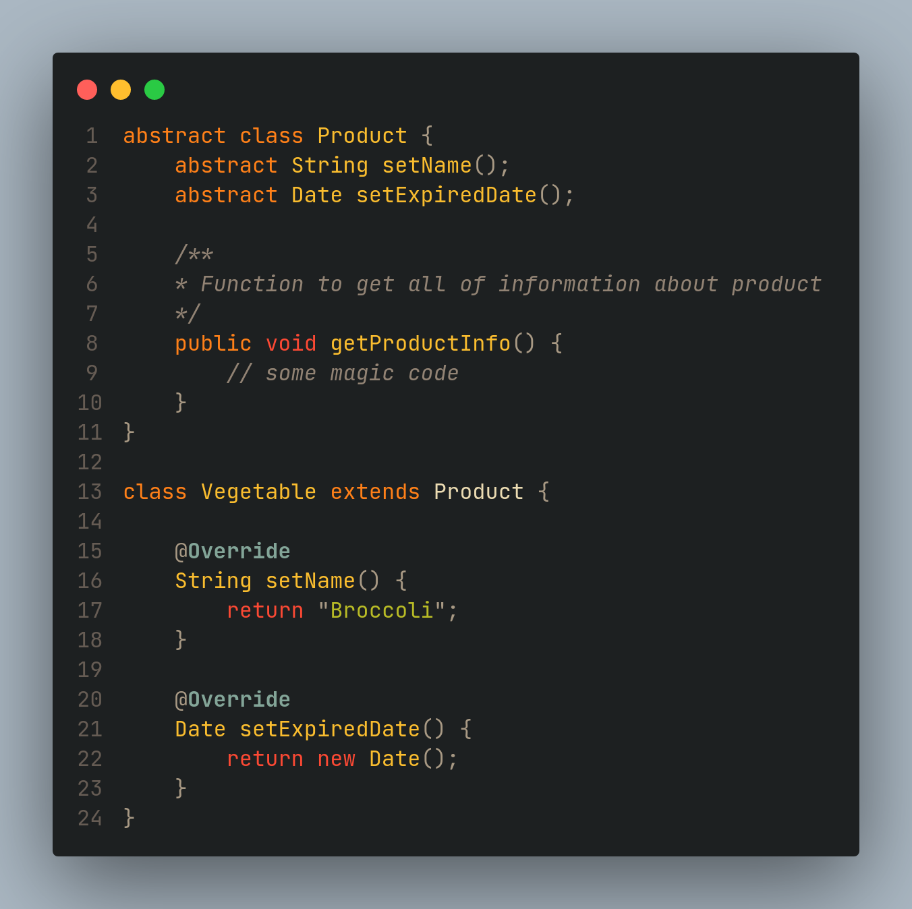
Let's understand the LSP through an example

Slide 21
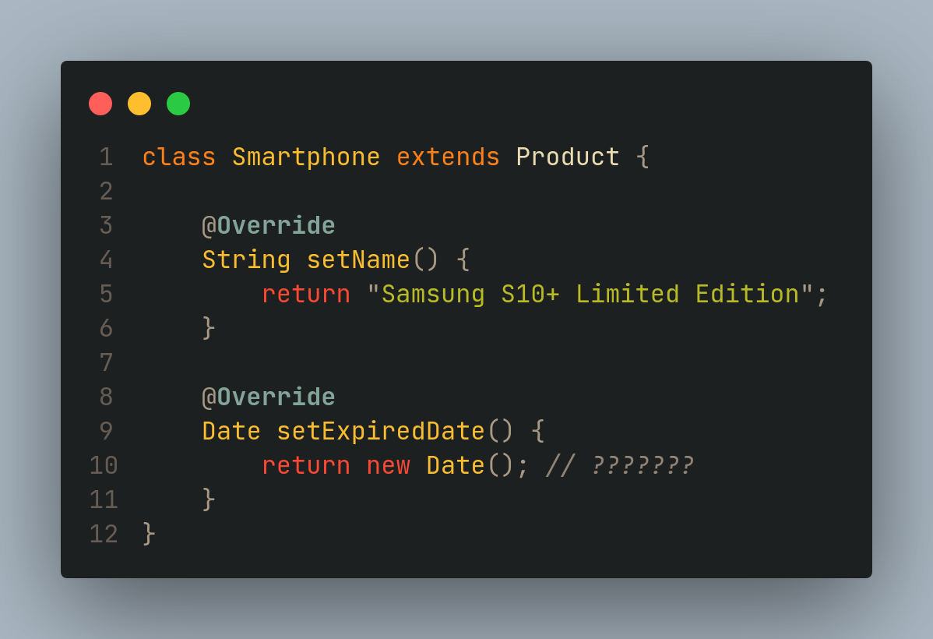
Ooops!
In this case the Product class becomes irrelevant to be inherited to the Smartphone class and this certainly violates the SubClass rules

Slide 22
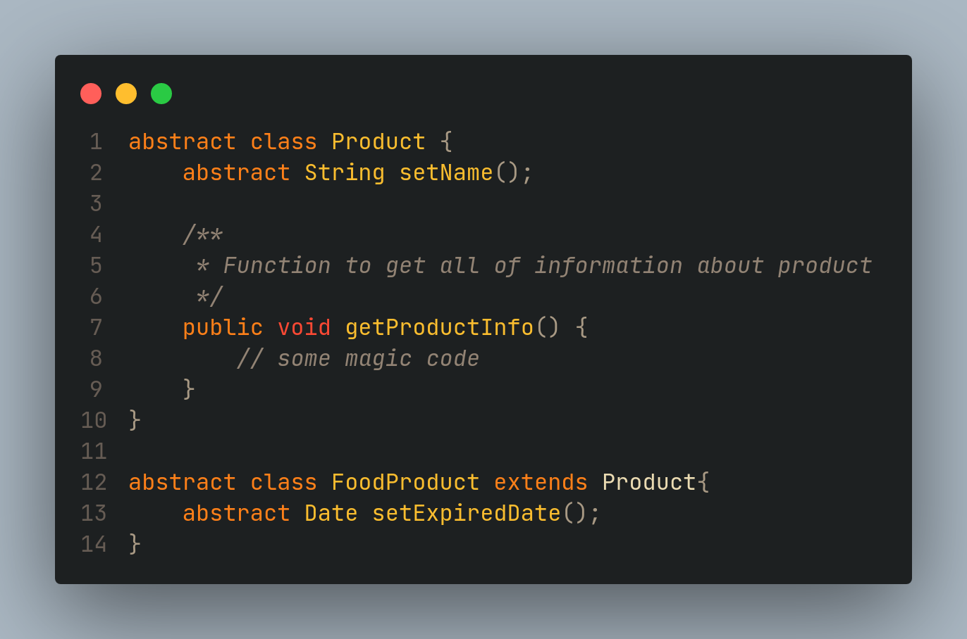
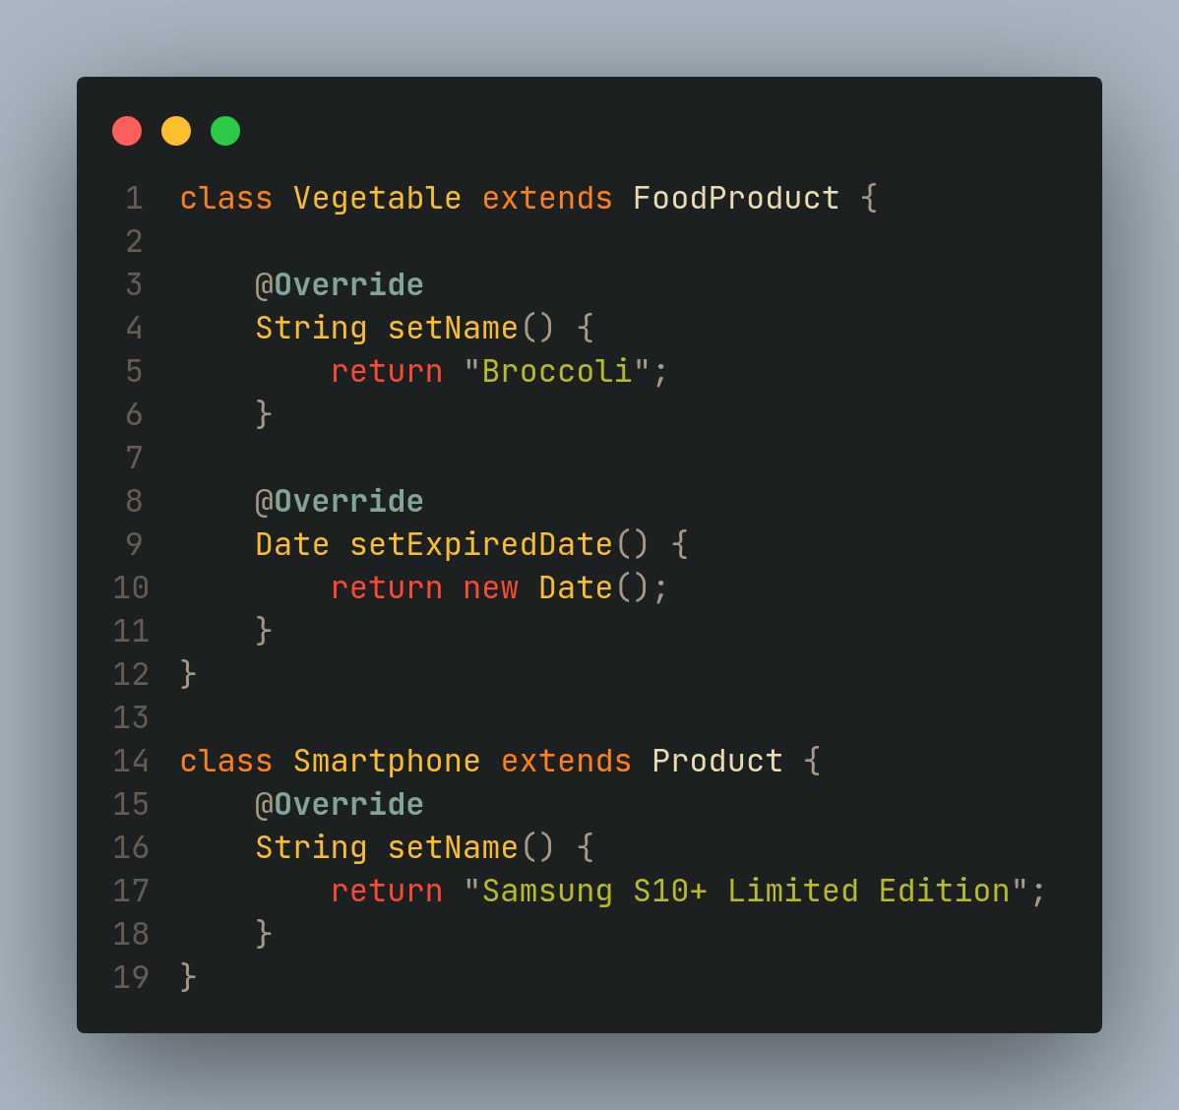
This change keeps the Product class a SuperClass

Slide 23
Interface Segregation Principle
The principle states that the larger interfaces split into smaller ones. Because the implementation classes use only the methods that are required. We should not force the client to use the methods that they do not want to use
The goal of the interface segregation principle is similar to the single responsibility principle
This principle itself aims to reduce the number of dependencies of a class on unneeded interface classes

Slide 24
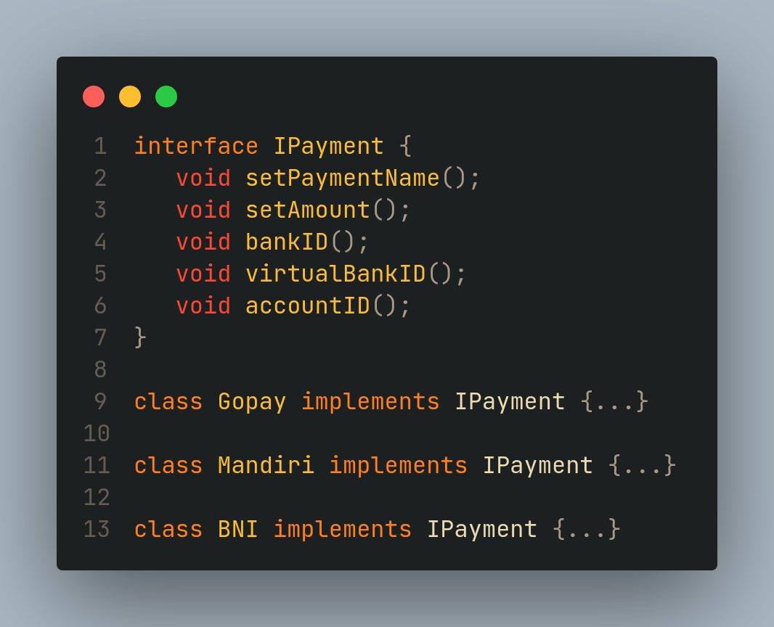
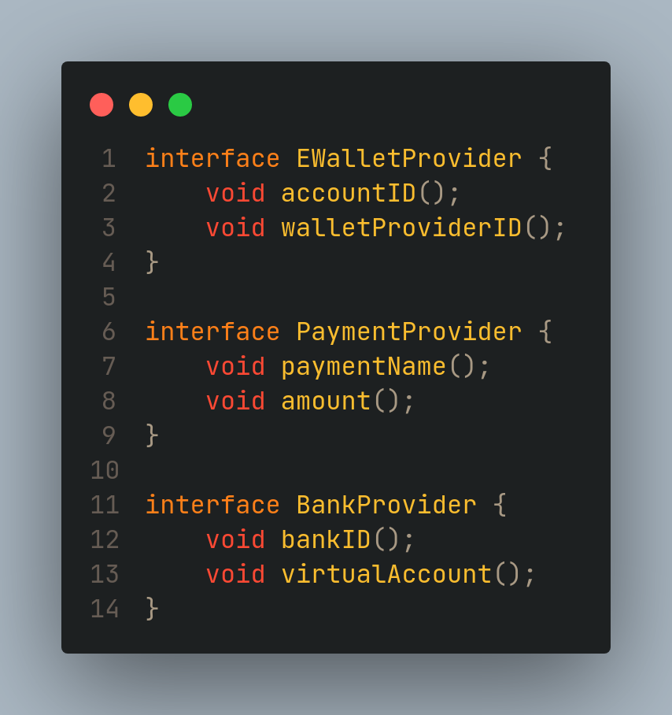
Let's understand the ISP through an example

Slide 25
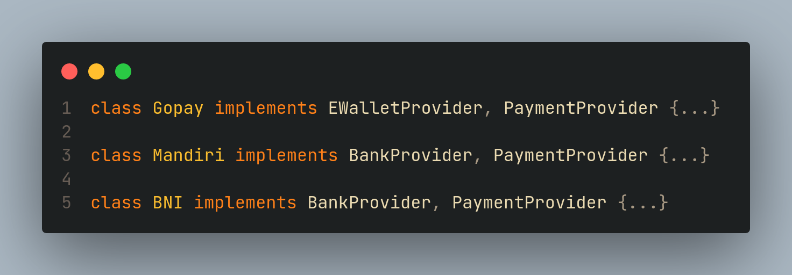
By breaking the interface into several small interfaces, we can easily customize the needs of each class.

Slide 26
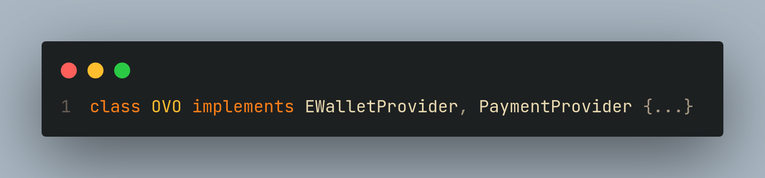

Slide 27
Dependency Inversion Principle
The principle states that we must use abstraction (abstract classes and interfaces) instead of concrete implementations. High-level modules should not depend on the low-level module but both should depend on the abstraction (Robert Cecil Martin)
High-level modules are classes that deal with bundles of functionality
Low-level modules are responsible for more detailed operations. At the lowest level allows this module to be responsible for writing information to the database

Slide 28
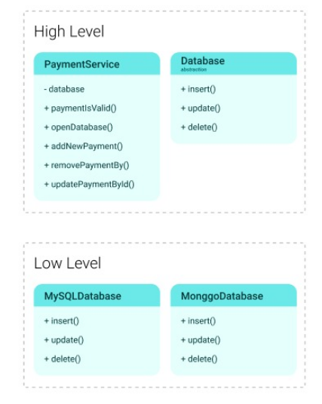
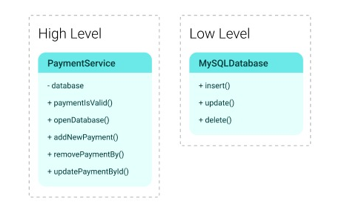

Slide 29
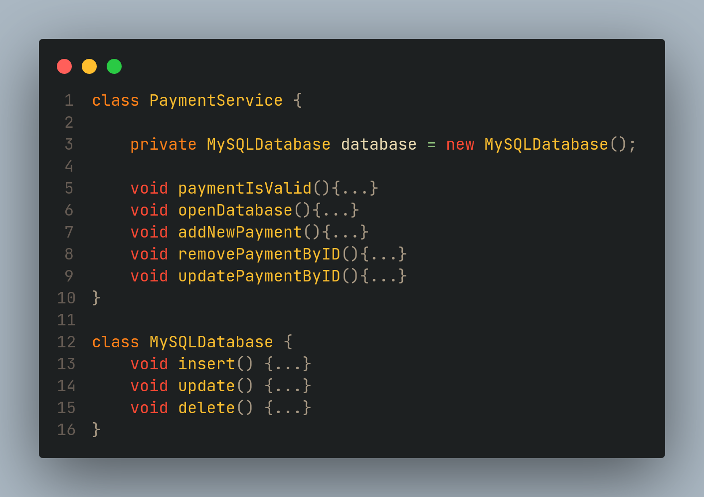
The problem is that this class depends on the database class and has a direct reference to that class as its property. Another problem that will arise is when we need a change to the MySQLDatabase class, where changes to that class can affect the above class, namely PaymentService.

Slide 30
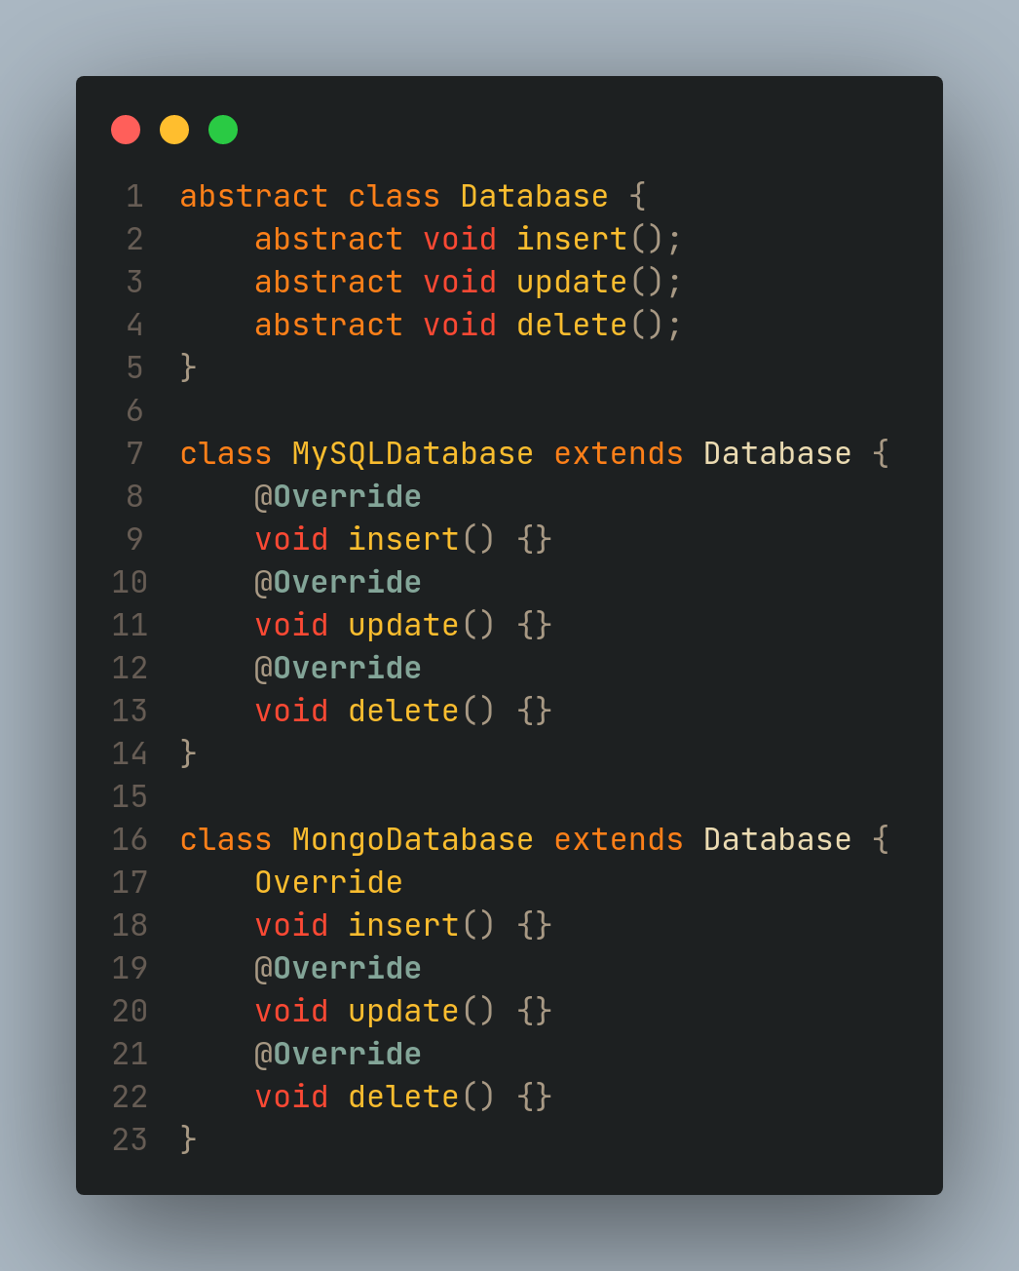
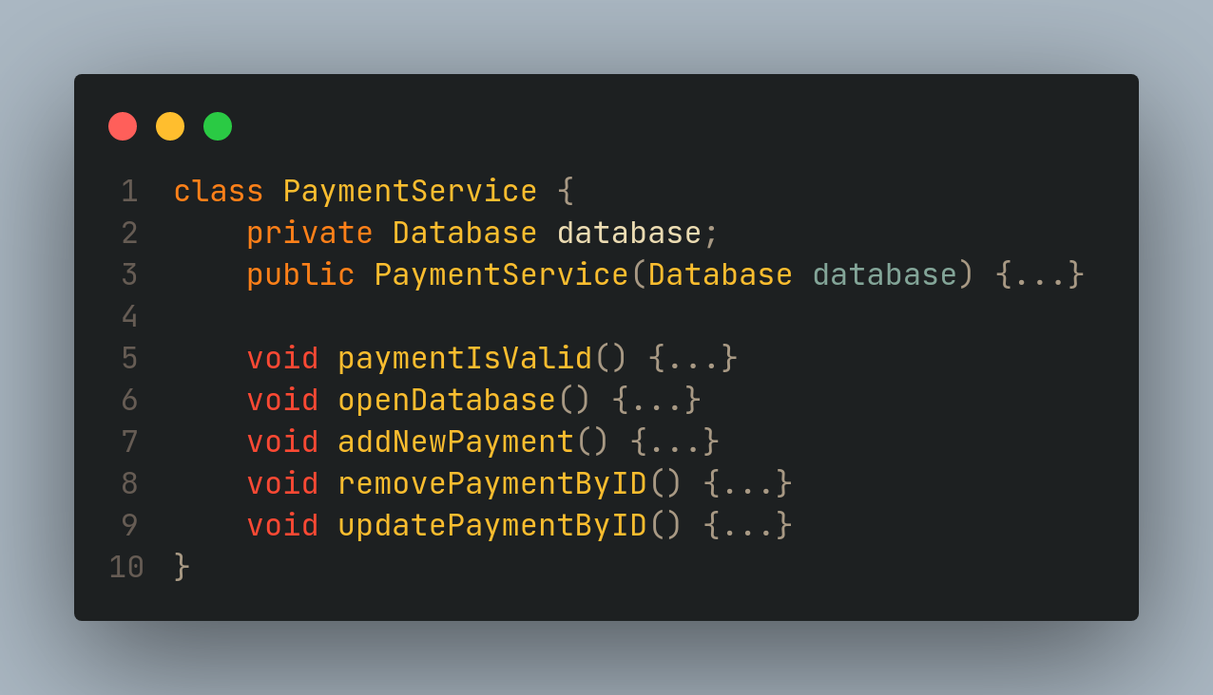

Slide 31
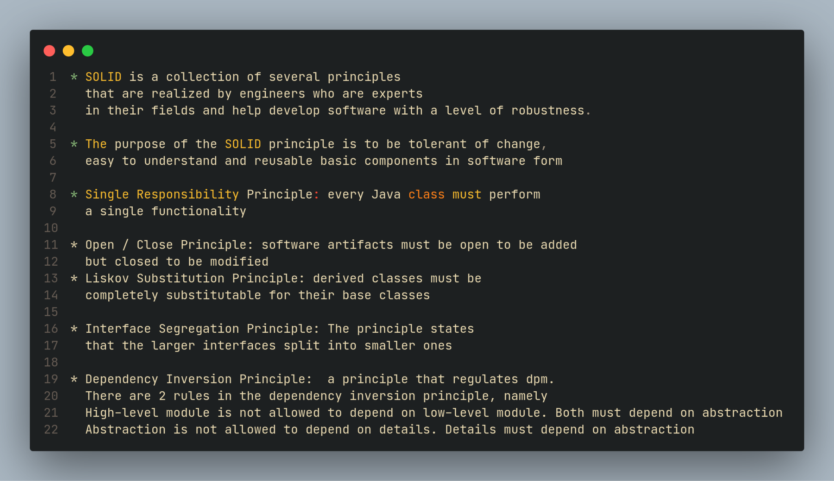

Slide 32
Thanks ~

Slide 33
Any Questions?
SLIDE : https://github.com/SemmiDev/SOLID/blob/main/SOLID%20Principles.pptx

